Slide 1
Broadening Participation in Computing
Myrtle Beach
2016
Anthony Basham
Gloria Townsend

Slide 2
Goal for Today:
Myrtle Beach
2016
Leave this session, armed with concrete ideas for recruitment based upon our successful models and those of other audience members

Slide 3
Who Are the Underrepresented?
Myrtle Beach
2016
Students-of-color
Women
Low-income students
First-generation students . . .

Slide 4
Statistics for Bachelor’s Degrees in Pure Computer Science
Myrtle Beach
2016
4.5% students-of-color
6.5% Hispanic students
14% women
8% low-income students (Parents <$25K)
3% first-generation students

Slide 5
Why Do We Care?
Myrtle Beach
2016
Industry cares:
Diverse teams create better products
Predicted technology job shortages
Individuals care:
Possible discrimination: overt or covert
Discrimination is never “right”

Slide 6
What Can We Do?
Myrtle Beach
2016
Berea perspective: Anthony Basham
DePauw perspective: Gloria Townsend
Audience perspective: YOU!

Slide 7
Berea College
Myrtle Beach
2016
Belongs to the STARS Alliance
Coalition of 53 schools
Annual leadership conference
http://starscomputingcorps.org/stars-computing-corps-application

Slide 8
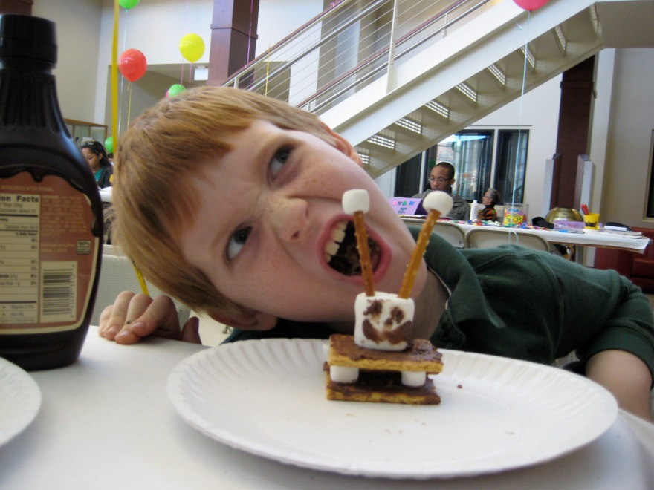
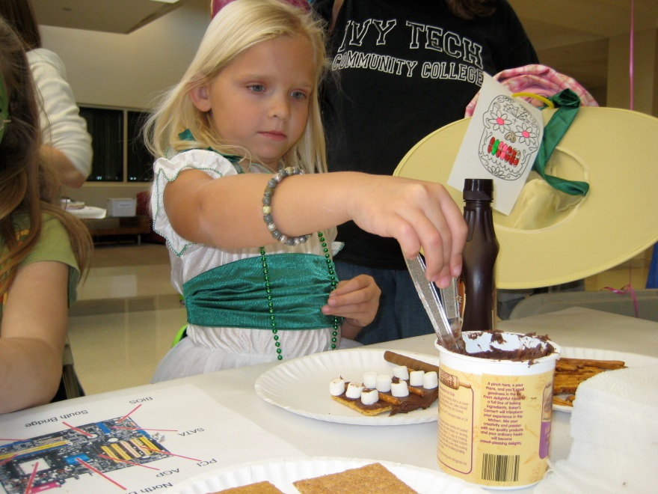
Idea #1
Myrtle Beach
2016
Outreach
Reciprocal!

Slide 9
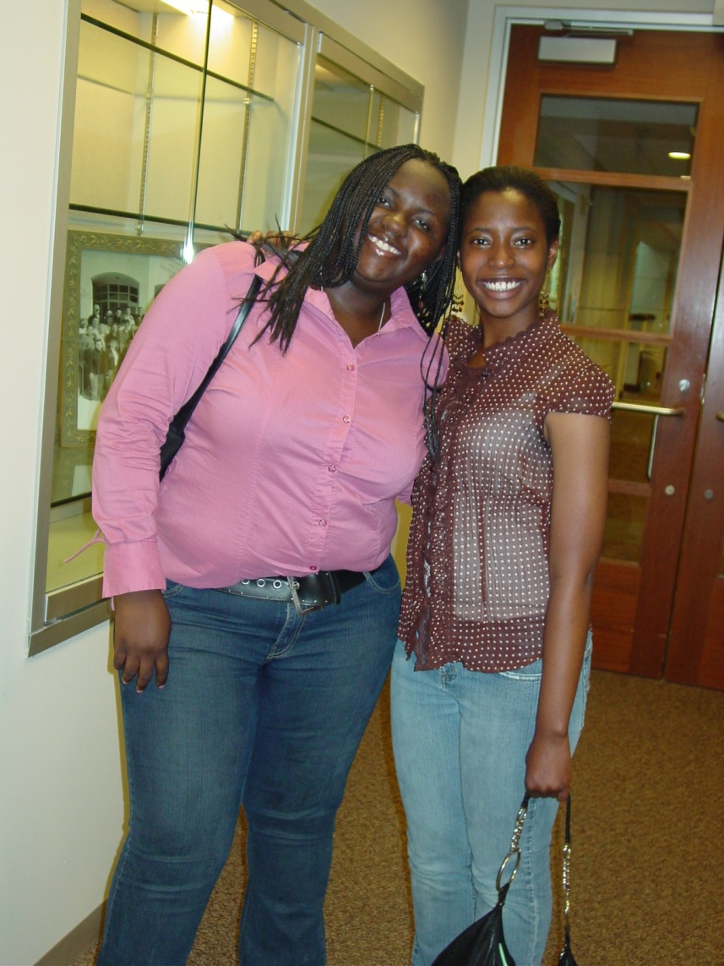
Idea #2
Myrtle Beach
2016
Mentoring

Slide 10
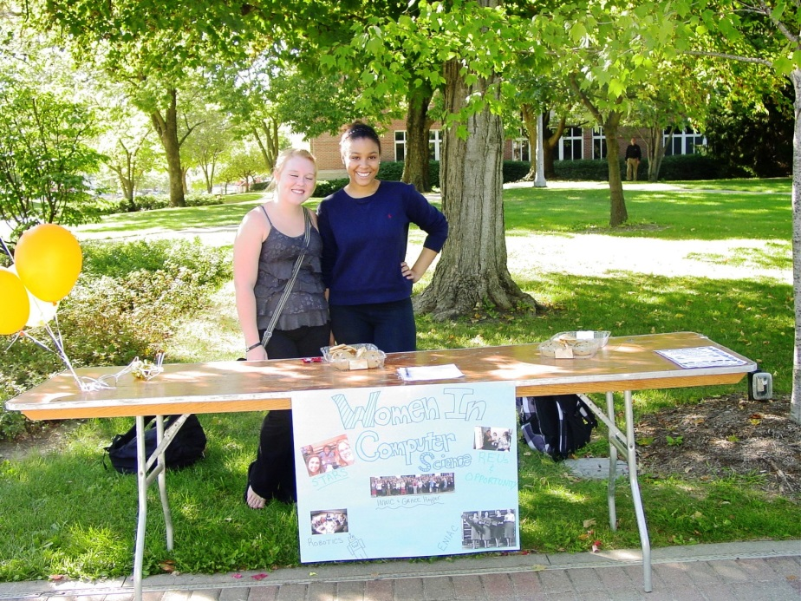
Idea #3
Myrtle Beach
2016
Participate in any campus-wide "fairs". Often chances to meet students through Orientation time, etc.

Slide 11
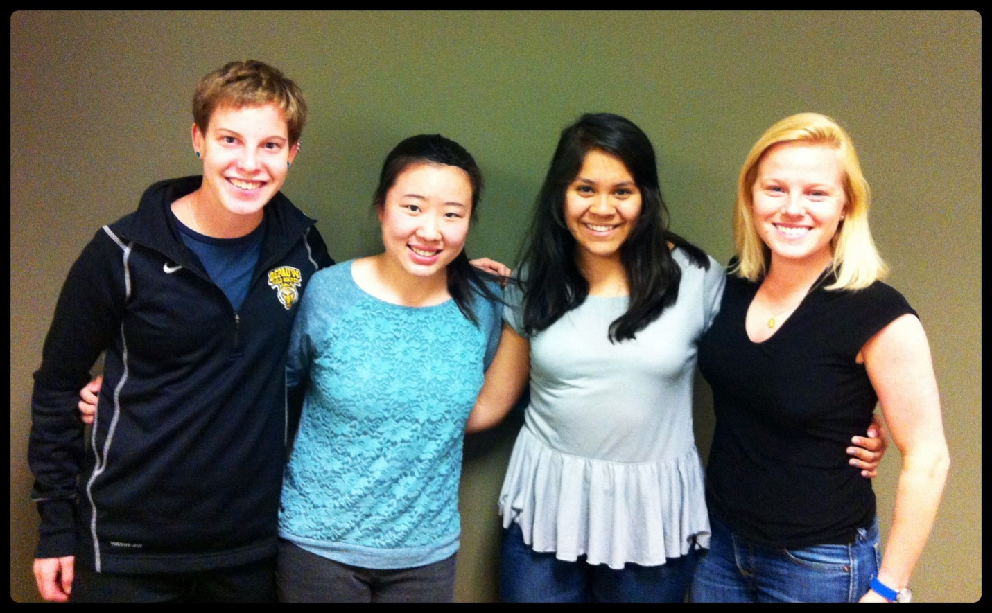
Idea #4
Myrtle Beach
2016
Encourage Imagine Cup
and other
external
competitions

Slide 12
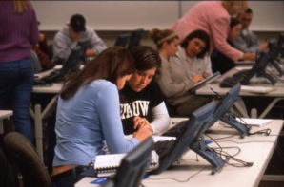
Idea #5
Myrtle Beach
2016
Collaboration
(not competition)

Slide 13
Idea #6
Myrtle Beach
2016
Peer Tutoring

Slide 14
Idea #7: CS0
A “gentler beginning” to CS helps many students
Typical CS degrees begin with CS1 (intro)
Berea: App Inventor, Alice, NXT Robots, and Game Development with Stencyl

Slide 15
Idea #8: High School Camps
STARS students teaching K-12
• Spheroes
• Nxt
• Etextiles
• Gamemaker
• Arduino Robots (make your own robot)

Slide 16
Idea #9: CS1 Internships
26 internships this summer, ranging from working with Red Hat to on-campus programming projects
Last year:
12 internships
6 Research projects (on-campus and REUs at other institutions)

Slide 17
DePauw University
Myrtle Beach
2016
Has an ACM-W Chapter
Network of 150 chapters world-wide
Budget for networking, etc.
http://www.acm.org/chapters/students/form-acmw

Slide 18
Idea #1
Myrtle Beach
2016
Ask underrepresented CS juniors and seniors to speak to CS1 classes about their projects, internships, research, job offers, and other opportunities

Slide 19
Idea #2
Myrtle Beach
2016
Send email to all women in CS1 classes all semester long, inviting them to ACM-W events (role-modeling, mentoring and social support)

Slide 20
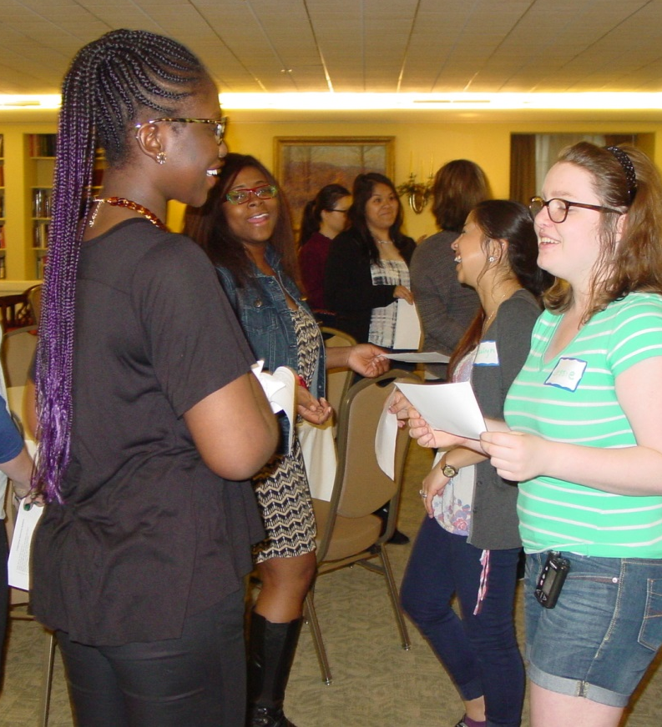
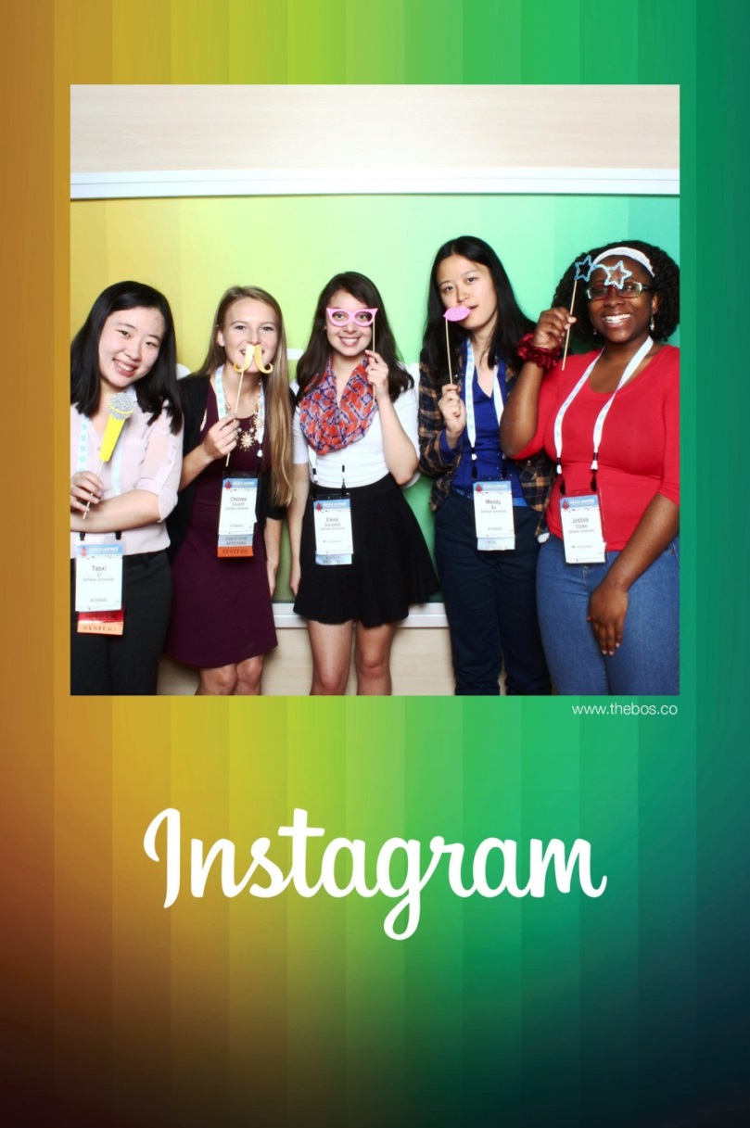
Idea #3
Myrtle Beach
2016
Invite students to Grace
Hopper Celebrations and to
ACM-W Celebrations
and…

Slide 21
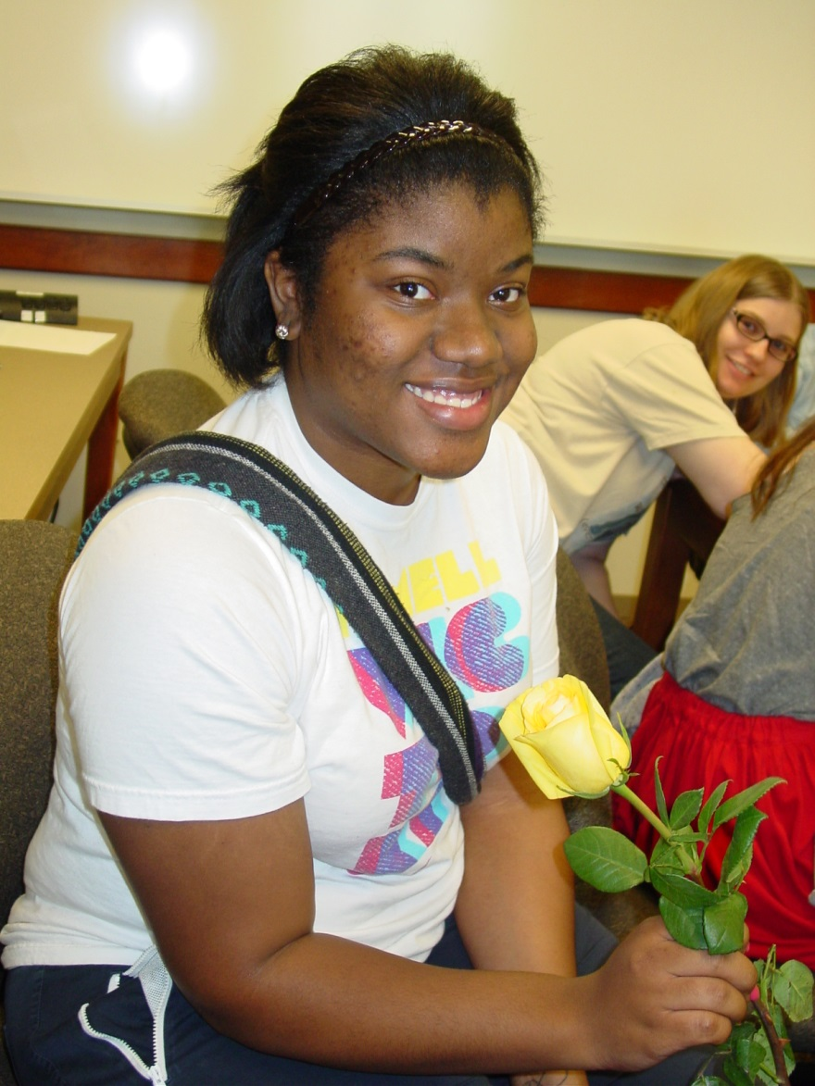
Idea #4
Myrtle Beach
2016
Use ACM-W students to
recruit and to staff lab
positions
(role-modeling)

Slide 22
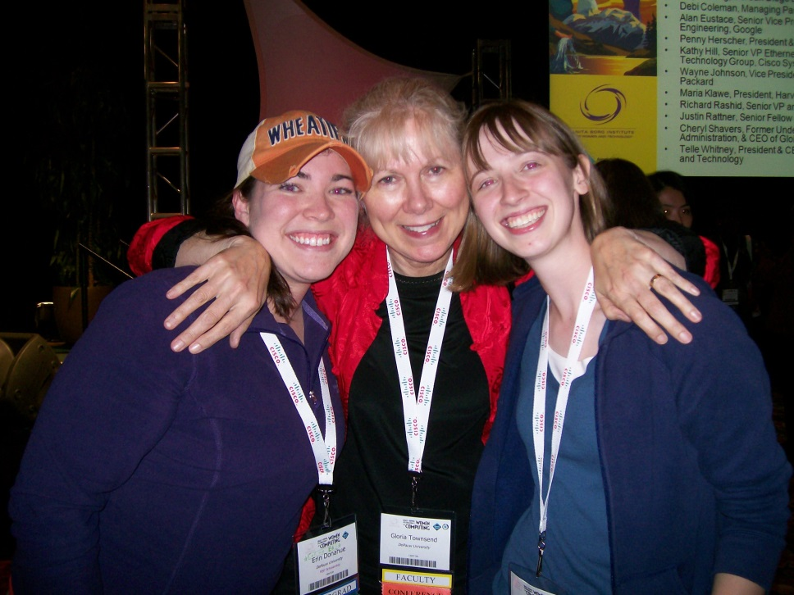
Idea #5
Myrtle Beach
2016
Encouragement!!

Slide 23
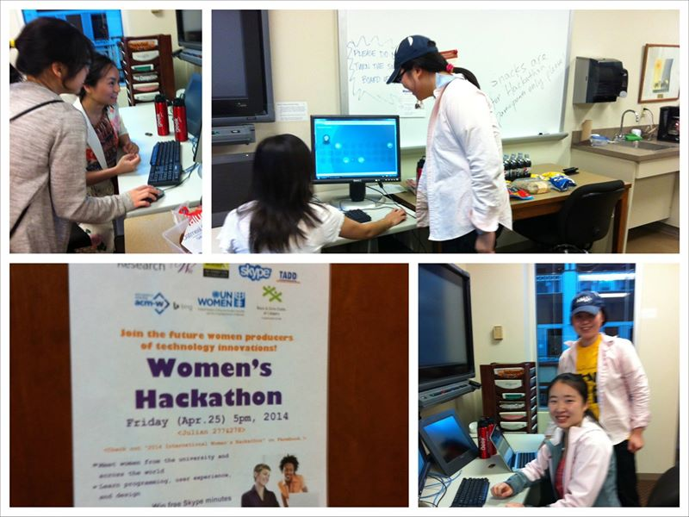
Idea #6
Myrtle Beach
2016
Bulletin Boards
You belong!

Slide 24
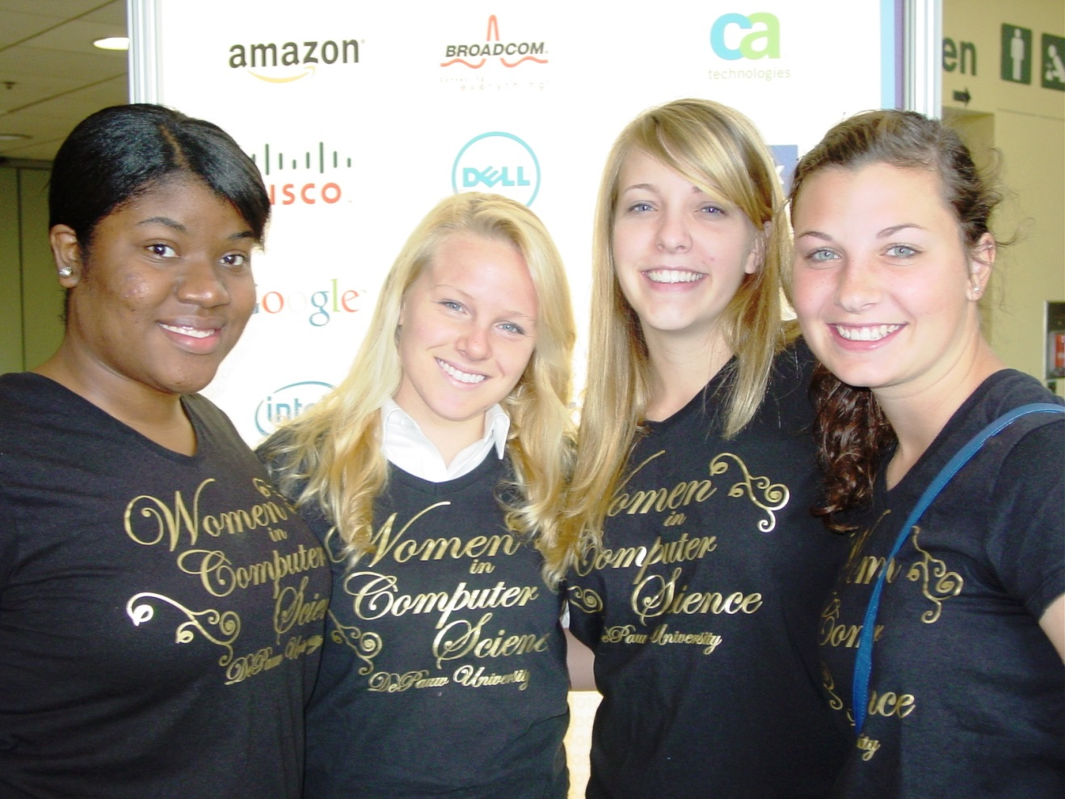
Idea #7
Myrtle Beach
2016
Practice is important (mind as elastic)

Slide 25
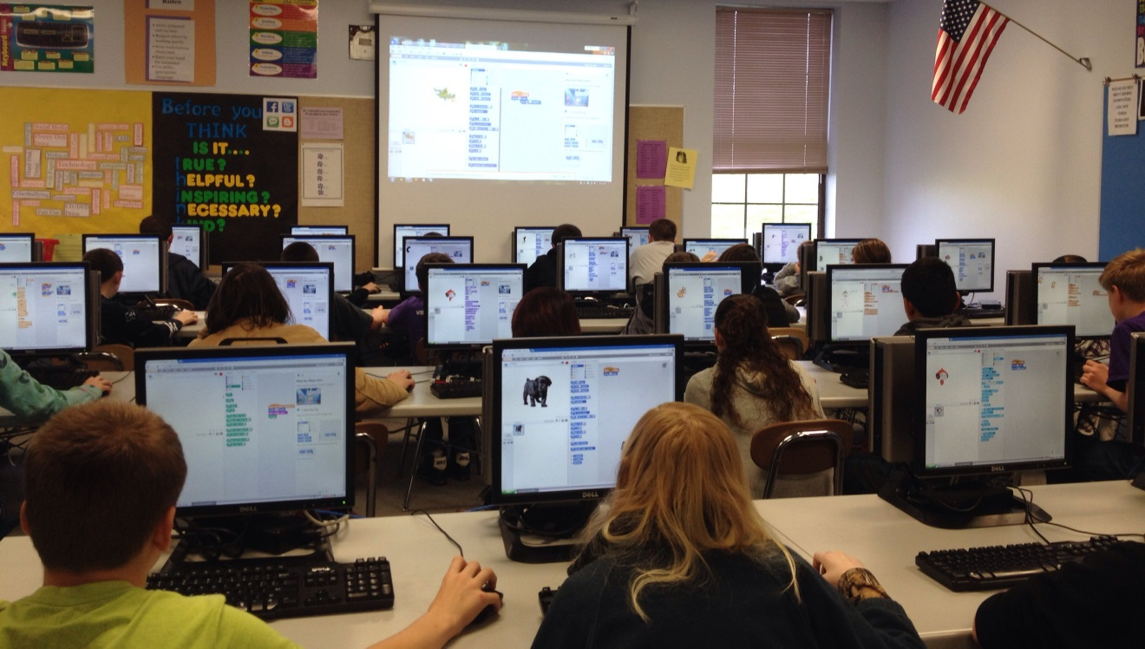
Idea #8
Myrtle Beach
2016
CLAUDE STEELE!! ("Some women have trouble…"; "You're doing really well for
a woman")

Slide 26
Thank You!
Myrtle Beach
2016
Anthony_Basham@berea.edu
gct@depauw.edu

