Slide 1
This is a library instruction session:
So, please turn off all cell phones, and if I catch you using cell phones, tablets, social media, wearables, etc. and not giving me your undivided attention while I talk about how robust academic databases are, I’m going to make you place your device in the front of the room, and possibly stand in the corner. (not true :))

Slide 2
Teaching Information Literacy & Research with Everyday Technology

Slide 3
Today = ideas, and hopefully you can apply to your discipline, and the focus is info lit and research

Slide 4
If you want to add research, but struggle with student ability

Slide 5
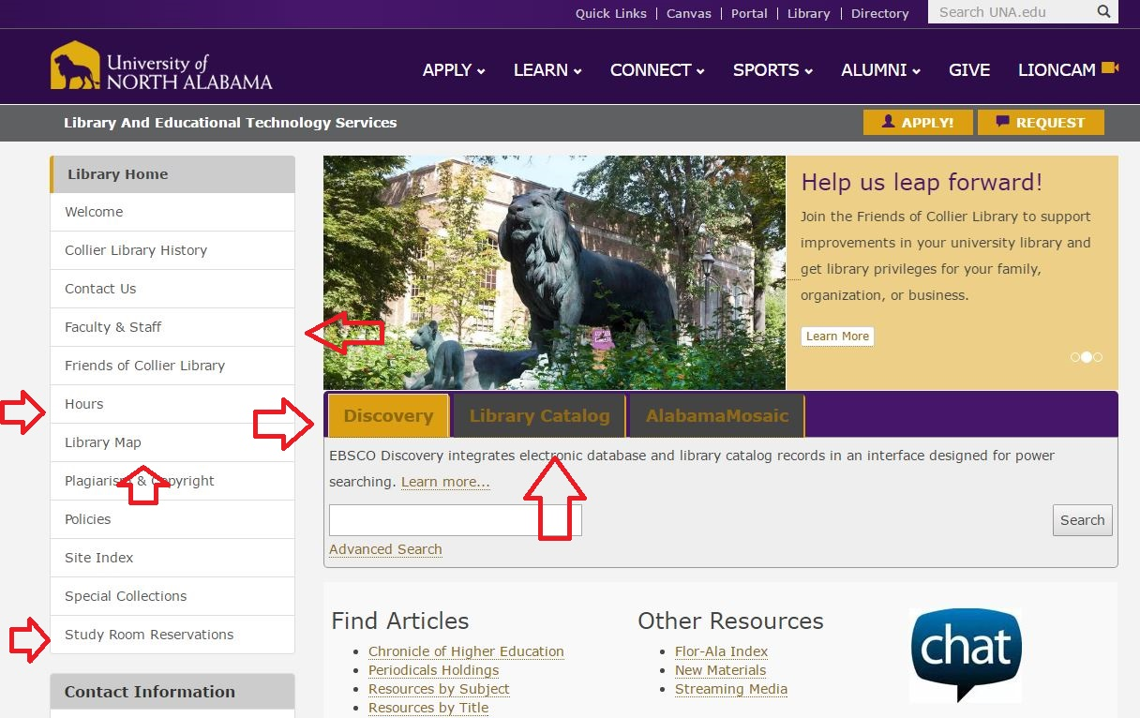
The traditional library & research instruction...

Slide 8
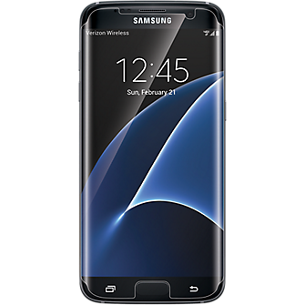
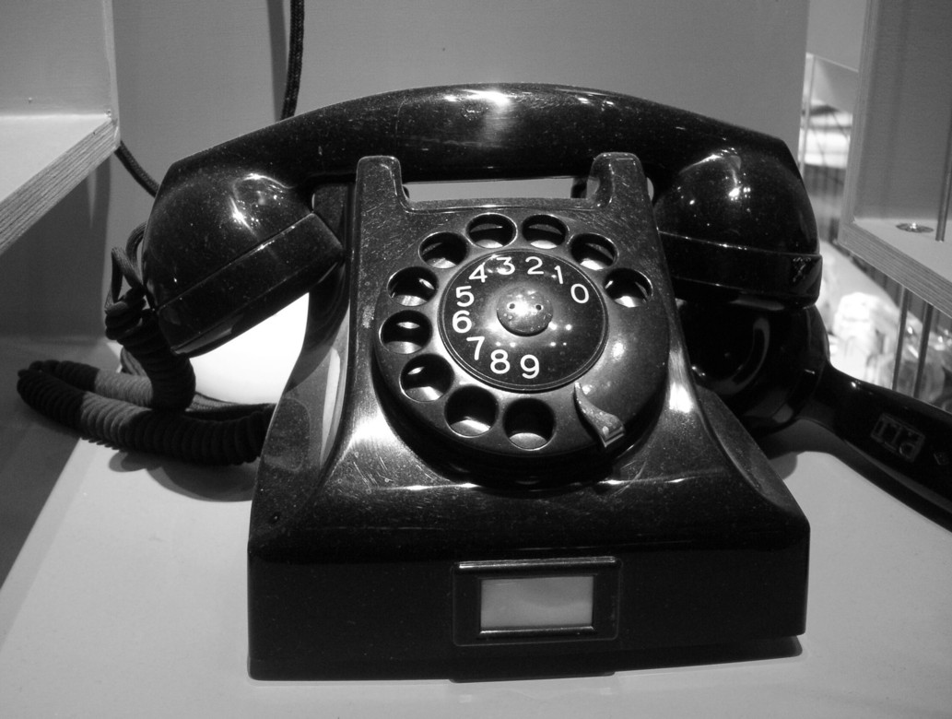

Slide 9
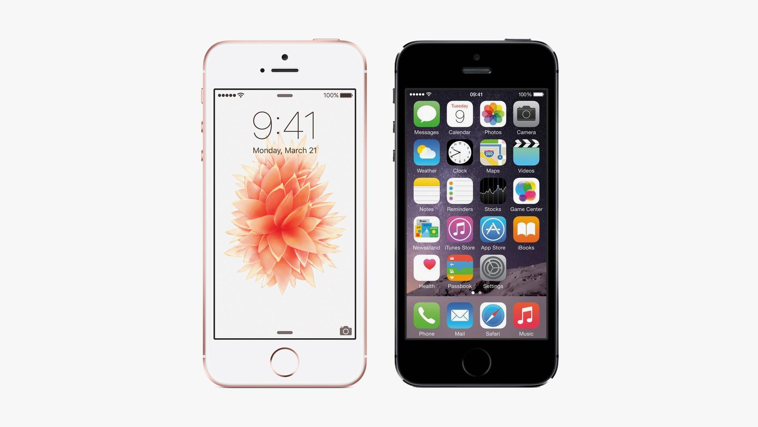
Infusing everyday technology - focus on mobile phone usage for info lit and research introduction

Slide 10
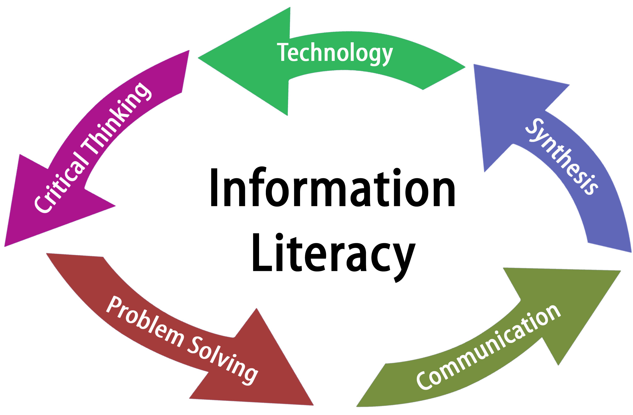
Our library instruction sessions at UNA..
Two primary types of instruction at UNA
Research/project specific instruction
Information literacy instruction

Slide 11
Research

Slide 12
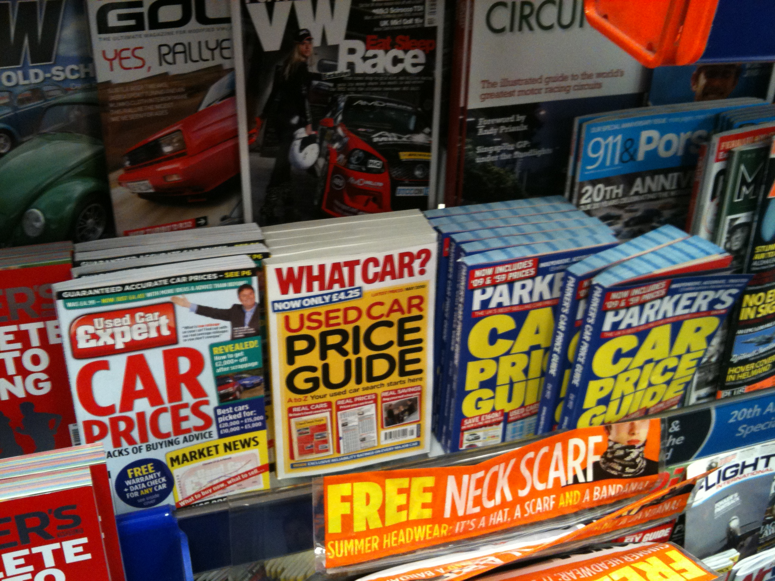
Research Defined
careful or diligent search
constant/everyday process

Slide 13
Our goal is to make this connection, and we’re doing so with their everyday technology
Personal life
=
Academic life

Slide 14
Information Literacy Defined
a set of abilities that allows you to “"recognize when information is needed and have the ability to locate, evaluate, and use effectively the needed information."”

Slide 15
Info lit broken down
Determine a NEED for information
ACCESS that information
EVALUATE that information
USE that information

Slide 16
Same goal, relate these to everyday (personal life)

Slide 17
CRAAP Test

Slide 18
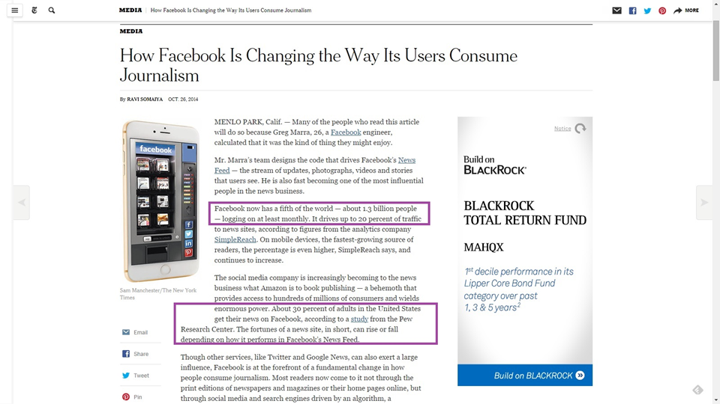
1st up, because Online information literacy is…...not good - Facebook

Slide 19
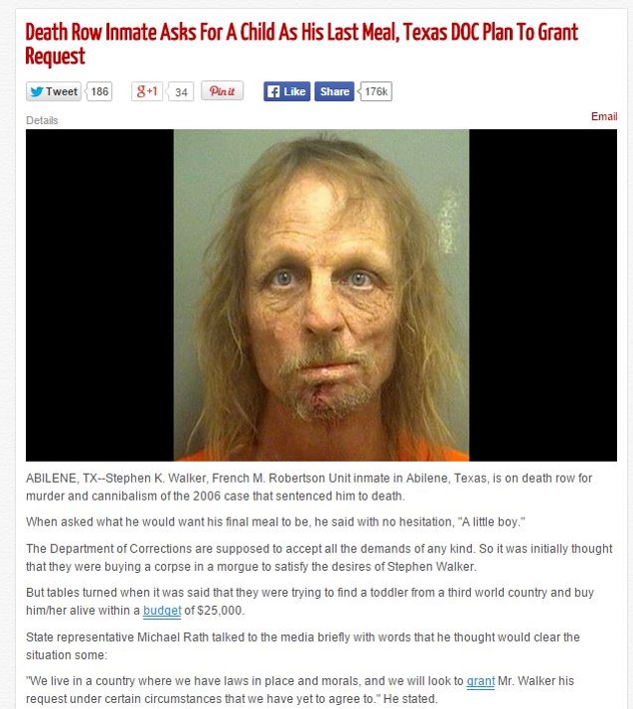
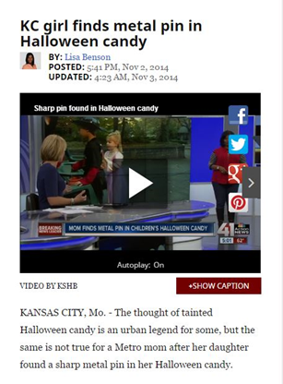
If it’s on Facebook, it’s true
and….memes

Slide 20
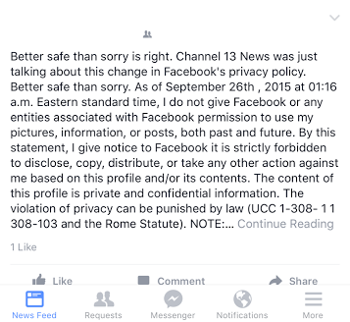
Facebook & the news, cont’d

Slide 21
Applying teaching info lit & research: Find something wrong
Challenge novice investigators to find something wrong on social media, and push them to call the bearer of bad news out

Slide 22
2 Stories

Slide 23
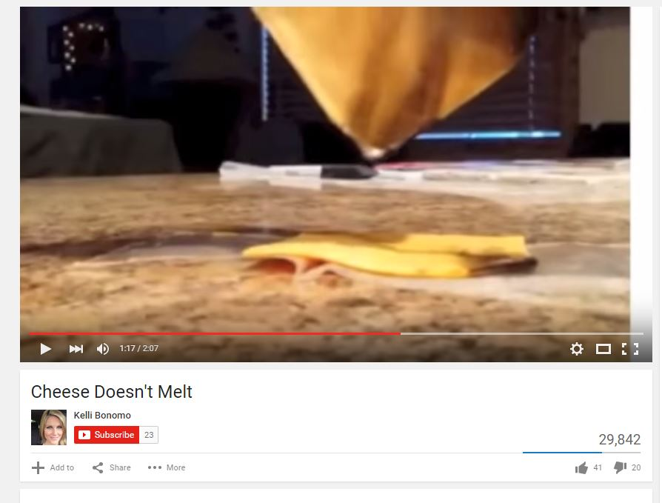
Another everyday technology for info lit - YouTube, where seeing is believing

Slide 24
Youtube, cont’d
Over 4 billion views a day and used a lot by 18-22 year olds
So, we show them bad stuff

Slide 25
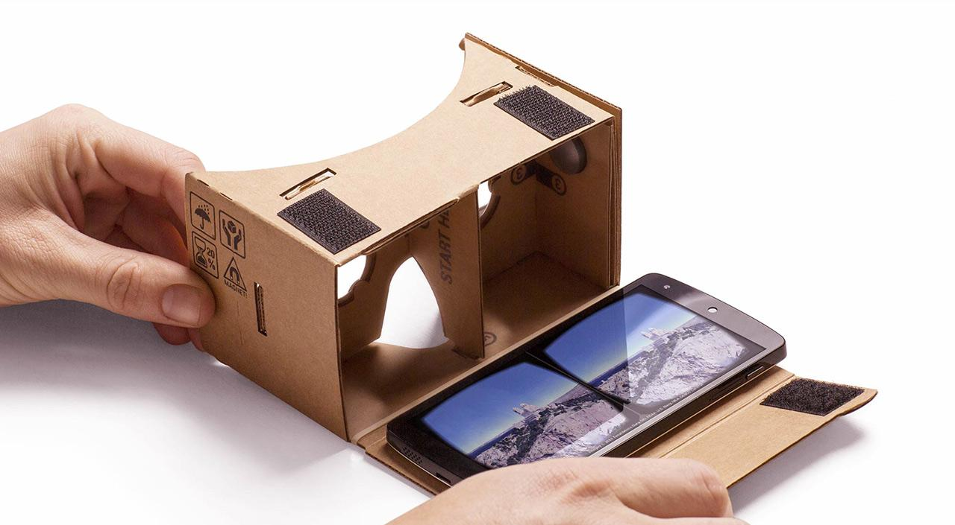
Applying teaching info lit & research: Evaluate videos
Evaluate based on experience and information (commentary, political ads, etc.)
Evaluate video techniques
Evaluate reality (360 videos)

Slide 26
Anonymous social media - an info lit treasure

Slide 27
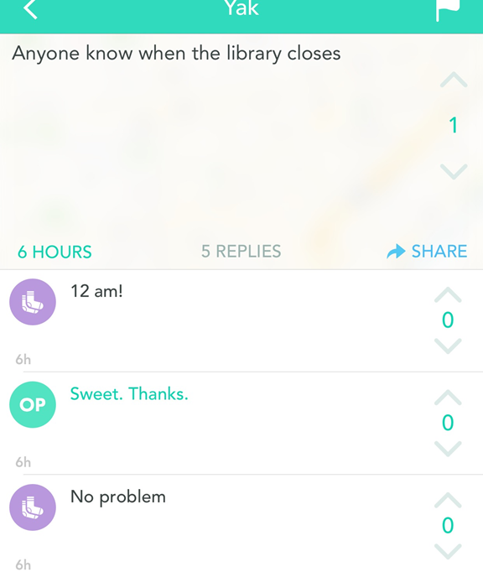
YikYak - where do you ACCESS information

Slide 28
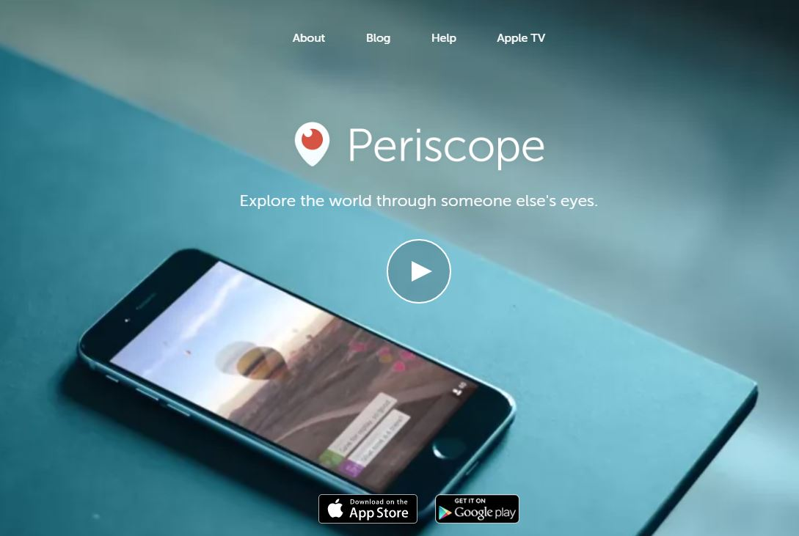
Periscope w/purpose
Access/Evaluate

Slide 30
The technology you use is your network, you must be information literate in your network first
How much do you trust this network?

Slide 31
Applying info lit: evaluate, evaluate, evaluate

Slide 32
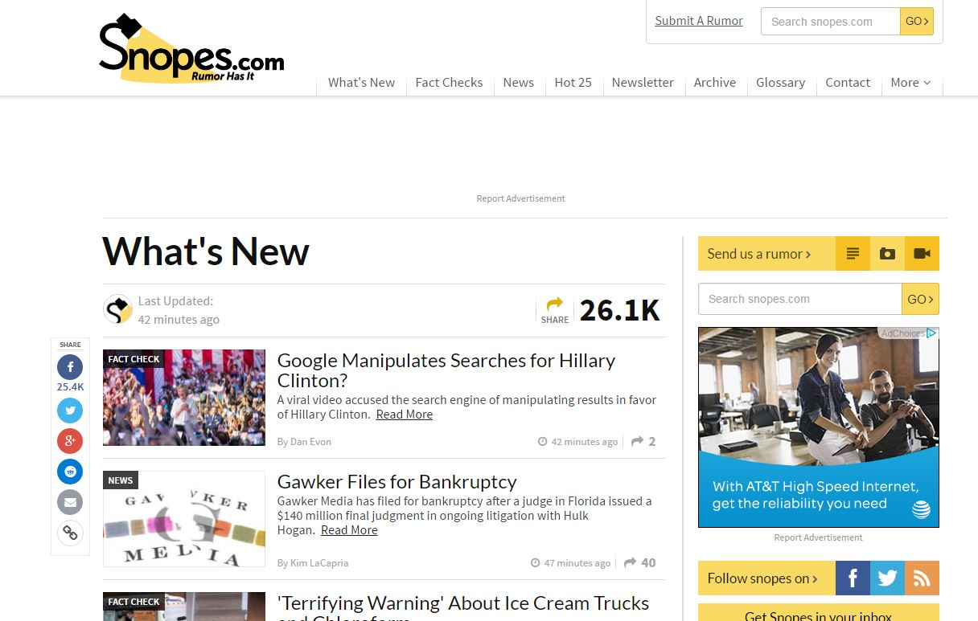

Slide 33
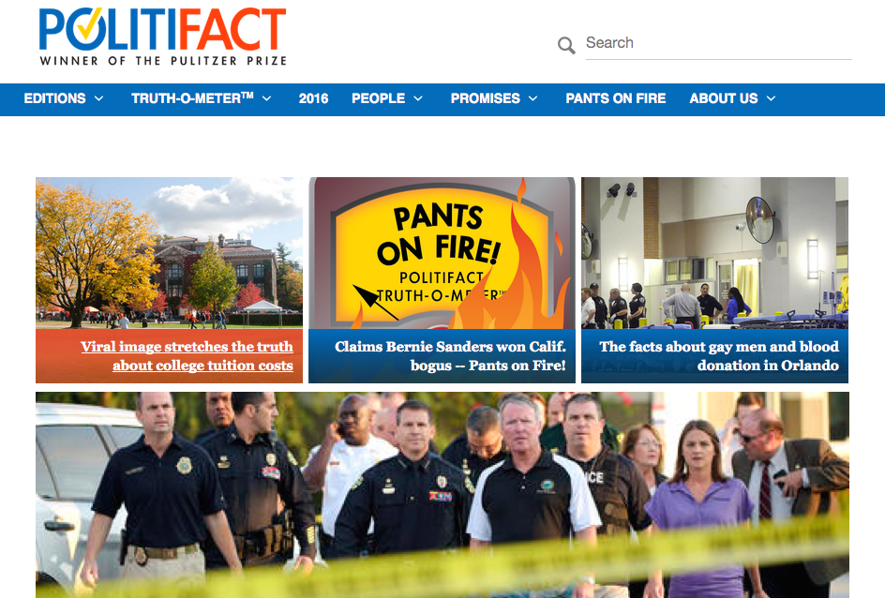
Politifact

Slide 34
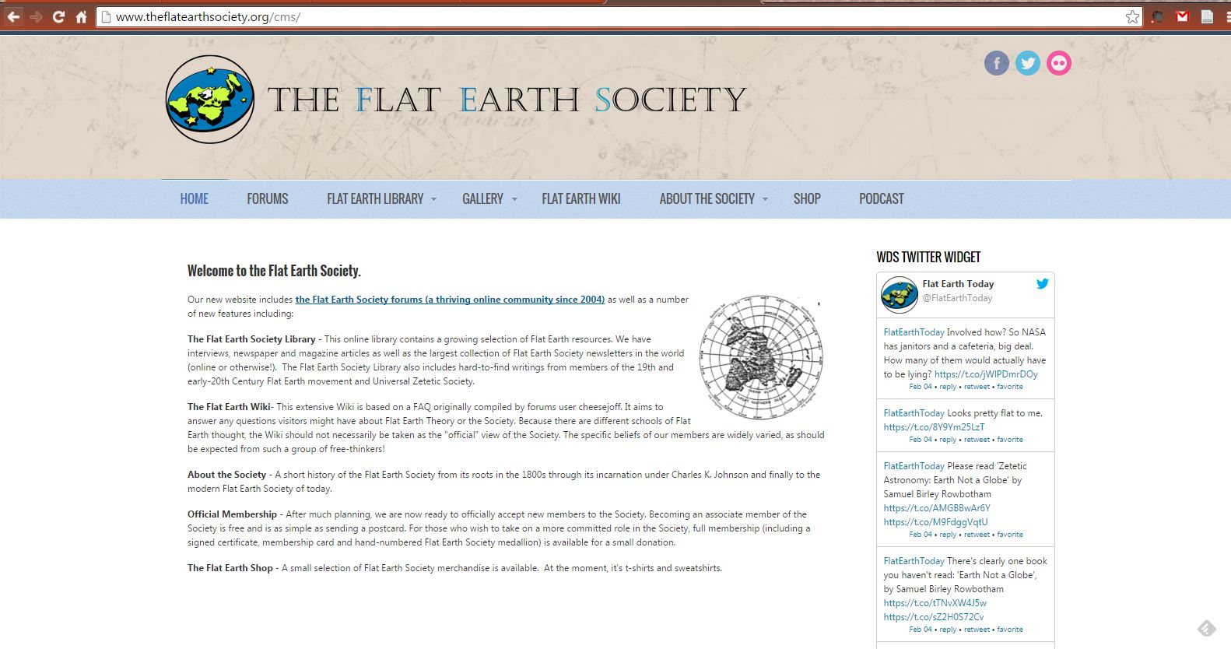
Conveying the importance of information literacy to college students/novice academic researchers

Slide 35
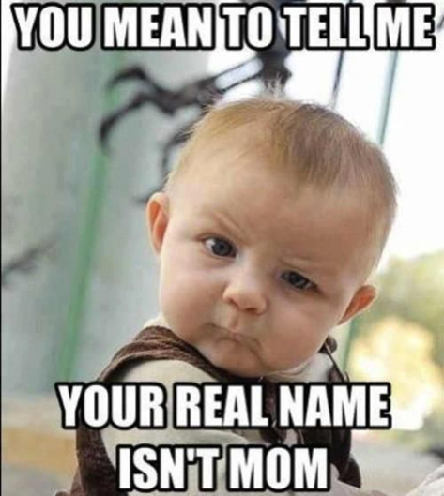
Encourage skepticism

Slide 36
Use it everyday technology, use it for everything
Identify what you need - determine the need for information
Search for exactly what you want in the right place - access the information
Verify before using - Evaluate information

Slide 37
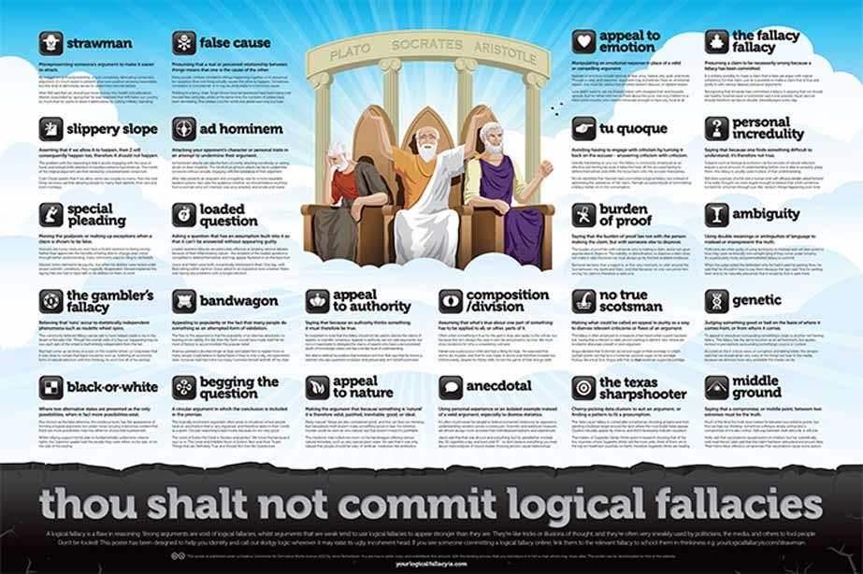
Moving forward

Slide 38
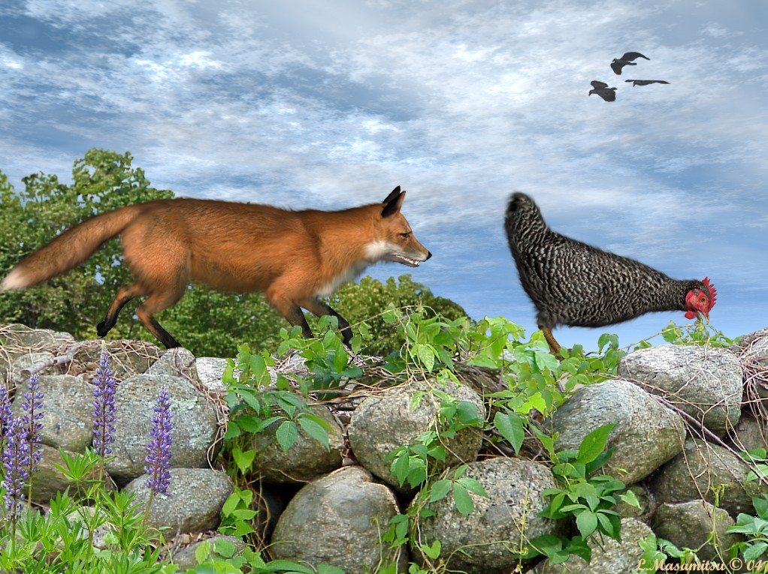
“You are unaware of how unaware you are.”

Slide 39
Questions?

